Slide 1
TEACHER’S PERSONAL INFORMATION
Name: Nguyen Thanh Loan
Facebook: Loan Nguyễn Thanh
Mobile number: 0942 255 937
Email: loannguyenthanh1978@gmail.com

Slide 2
UNIT 8
VOCABULARY PLUS
Language in action

Slide 3
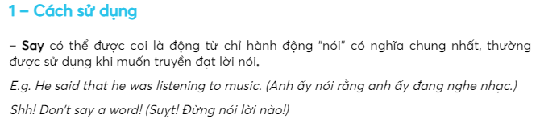
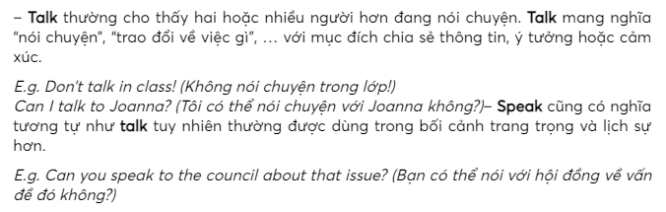
VOCABULARY PLUS
Speaking verbs: say, speak, tell, and talk

Slide 4
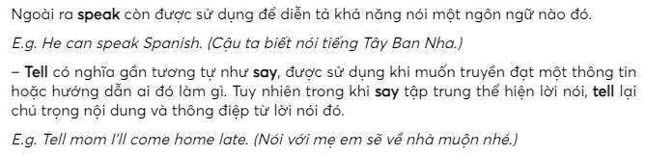
VOCABULARY PLUS
Speaking verbs: say, speak, tell, and talk

Slide 5
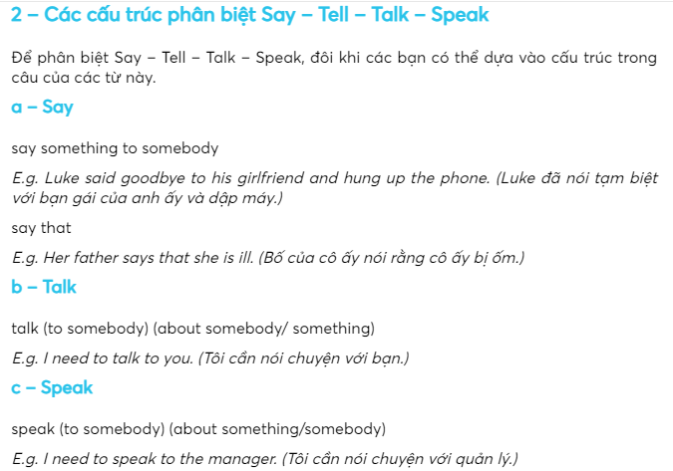
VOCABULARY PLUS
Speaking verbs: say, speak, tell, and talk

Slide 6
VOCABULARY PLUS
Speaking verbs: say, speak, tell, and talk
https://elight.edu.vn/phan-biet-say-tell-talk-speak/

Slide 7
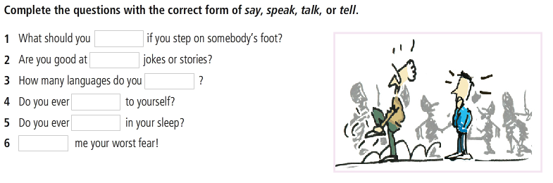
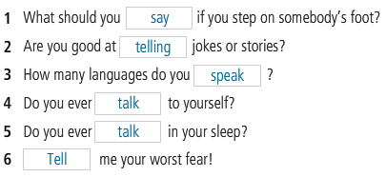
VOCABULARY PLUS
Speaking verbs: say, speak, tell, and talk

Slide 8
Adjective + to infinitive
A cell phone is easy to lose.
This question is difficult to answer.
A good translator is difficult to find.

Slide 9
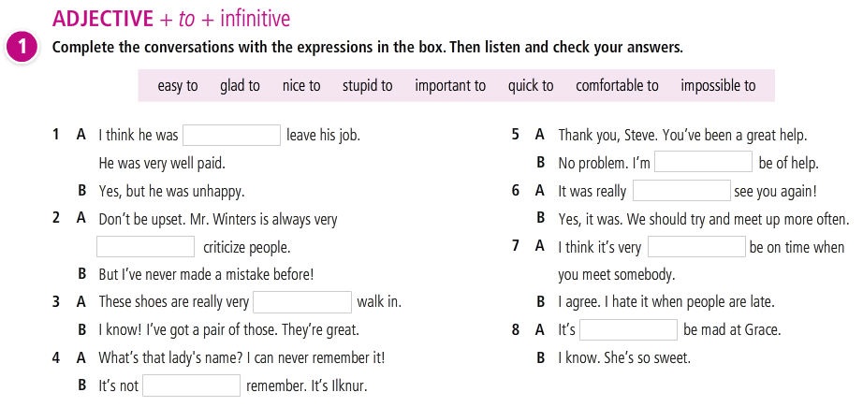
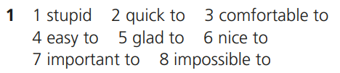

Slide 10
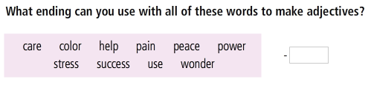
VOCABULARY PLUS
Worldbuilder: Adjectives
Careful, colorful, helpful, painful, peaceful, powerful, stressful, successful, useful, wonderful

Slide 11
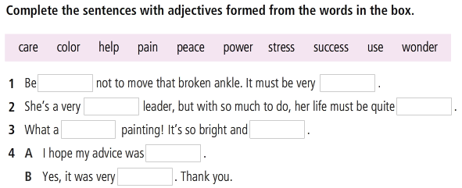
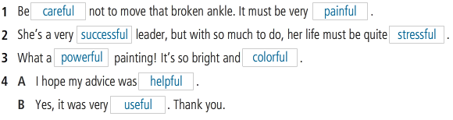
Worldbuilder: Adjectives
Careful, colorful, helpful, painful, peaceful, powerful, stressful, successful, useful, wonderful

Slide 12
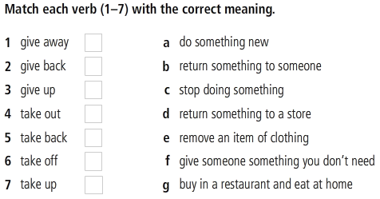

Focus on: “give” and “take”

Slide 13
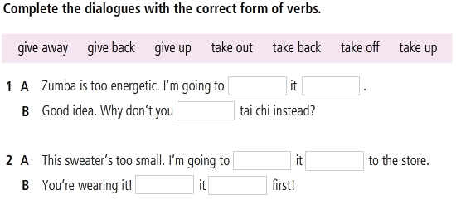
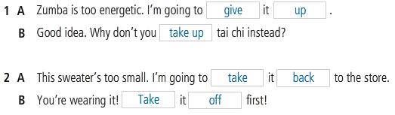
Focus on: “give” and “take”

Slide 14
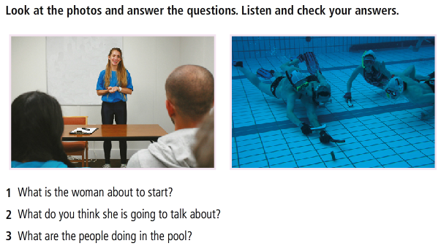
Language in action
Beginning and ending a talk

Slide 15
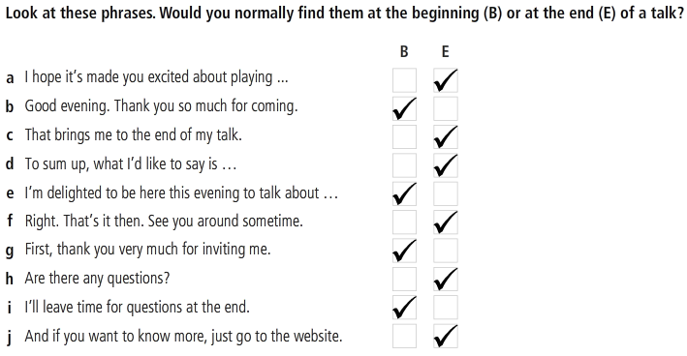
Beginning and ending a talk

Slide 16
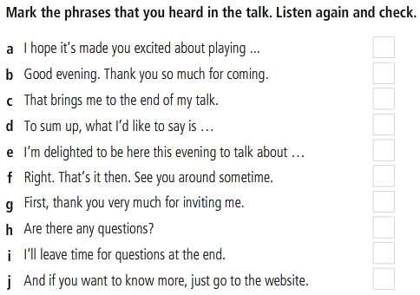

Beginning and ending a talk

Slide 17
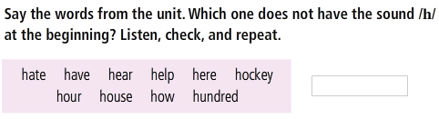
Beginning and ending a talk

Slide 18

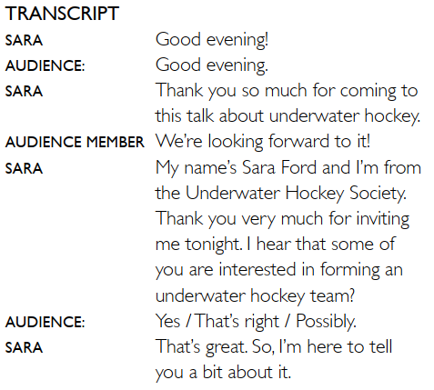
Beginning and ending a talk
Study Tecnique
Introduction
Khoi
RemNote Community of Vietnam
today
Studying in a smarter way

Slide 19
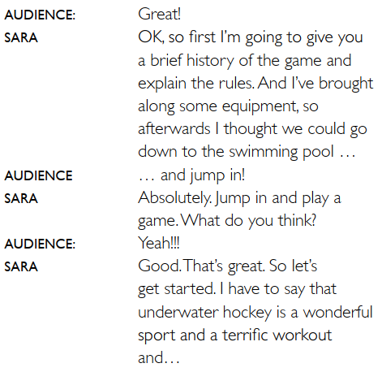
Beginning and ending a talk
Spaced Repetition Technique
I will introduce to you some tool for using this technique in your learning life after wards I thougt we could open the tool and
Beginning
Spaced Repetition is a powerful tool

Slide 20
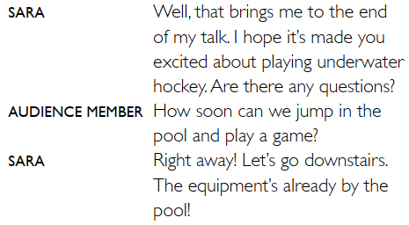
Beginning and ending a talk
Ending

Slide 21
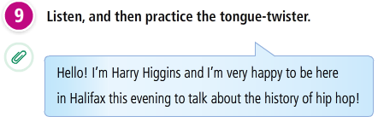
Practice: Beginning and ending a talk

Slide 22


Practice: Beginning and ending a talk
Prepare and practice a very short talk about any topic that interest you. Use phrases above to help you. And remember KISS!

Slide 23
References
Grammar: say, feel, talk, speak
elight.edu.vn/phan-biet-say-tell-talk-speak/
https://www.youtube.com/watch?v=3x3fLevpnrI
https://www.youtube.com/watch?v=07SvtdPvDFY

Slide 24
